Slide 1
iPad on Live
Presented by: Kristina Stanimirovich & Lidia Puga

Slide 3
Agriculture and Natural Resources 2. Arts Media and Entertainment 3. Building Trades and Construction 4. Education, Child Development, and Family Services 5. Energy and Utilities 6. Engineering and Design 7. Fashion and Interior Design 8. Finance and Business 9. Health Science and Medical Technology 10. Hospitality, Tourism, and Recreation 11. Information Technology 12. Manufacturing and Product Development 13. Marketing, Sales, and Service 14. Public Services 15. Transportation

Slide 4
“Would you be interested in using an iPad in your classroom?” -Teresa Matos Teacher on Special Assignment Sweetwater Union High School District Adult Division Career Technical Education

Slide 5
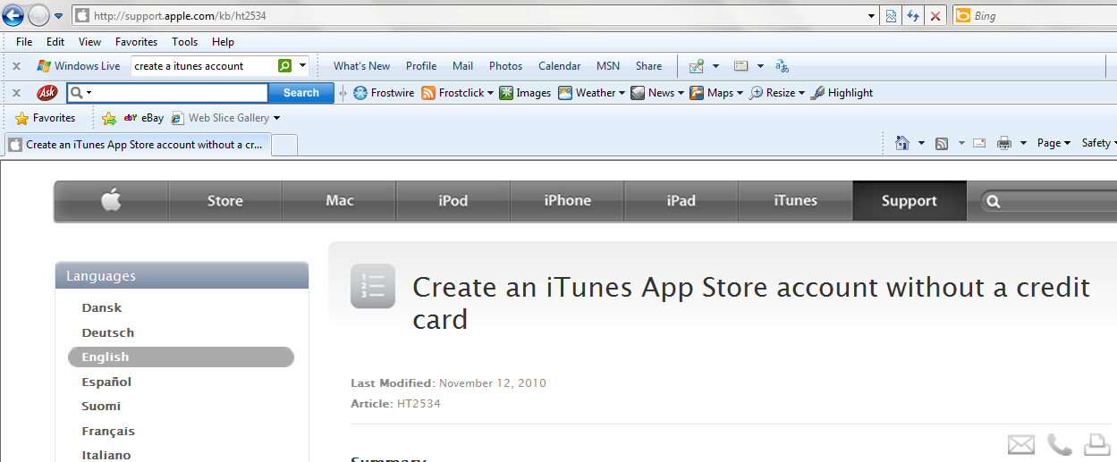

Slide 6
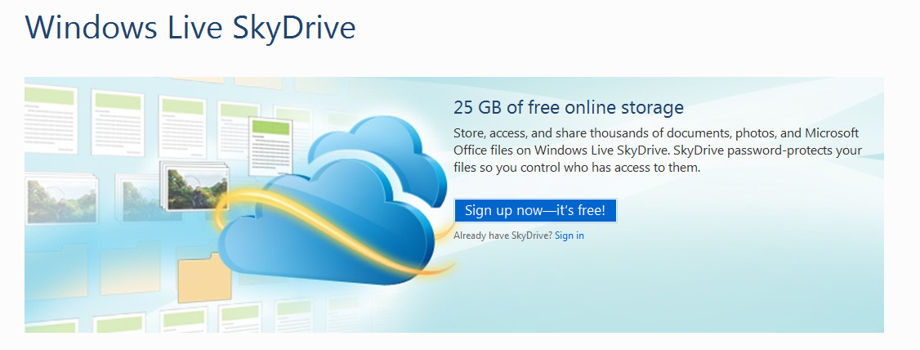
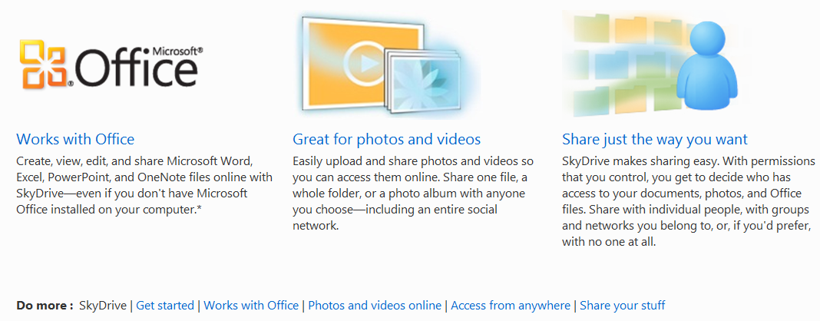

Slide 7
www.live.com

Slide 8
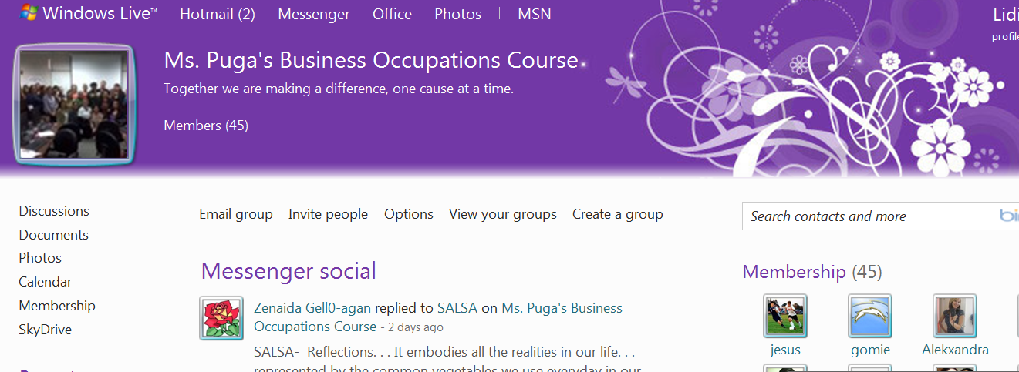
Group

Slide 9
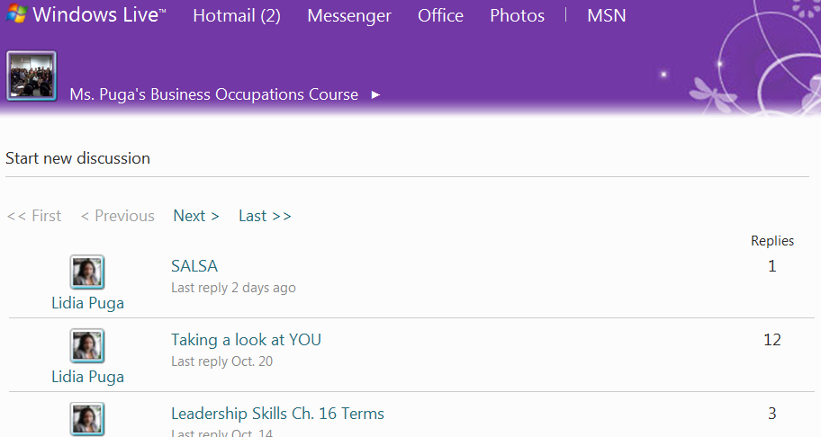
Discussion

Slide 10
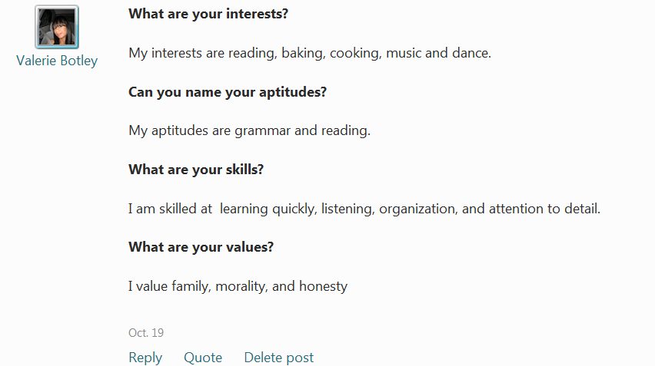
Post

Slide 11
C.U.E. Computer-Using Educators
8-13-2010

Slide 12
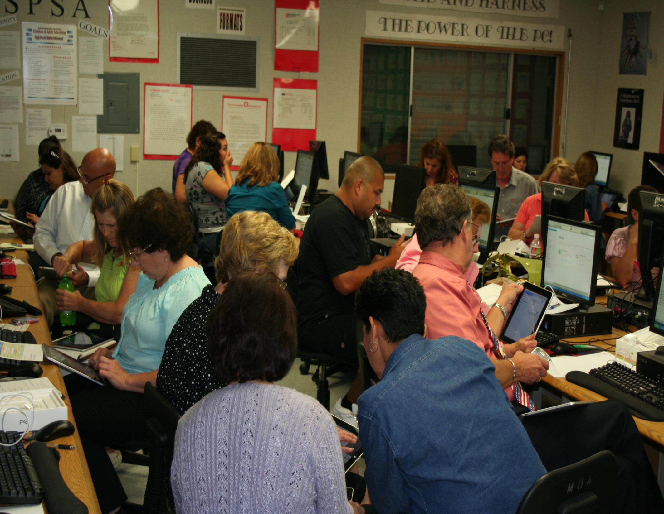

Slide 13
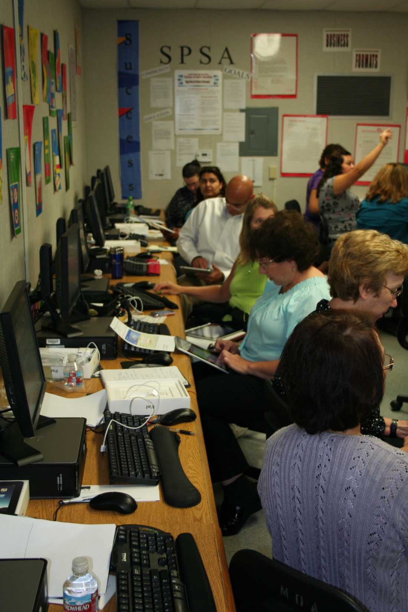

Slide 14
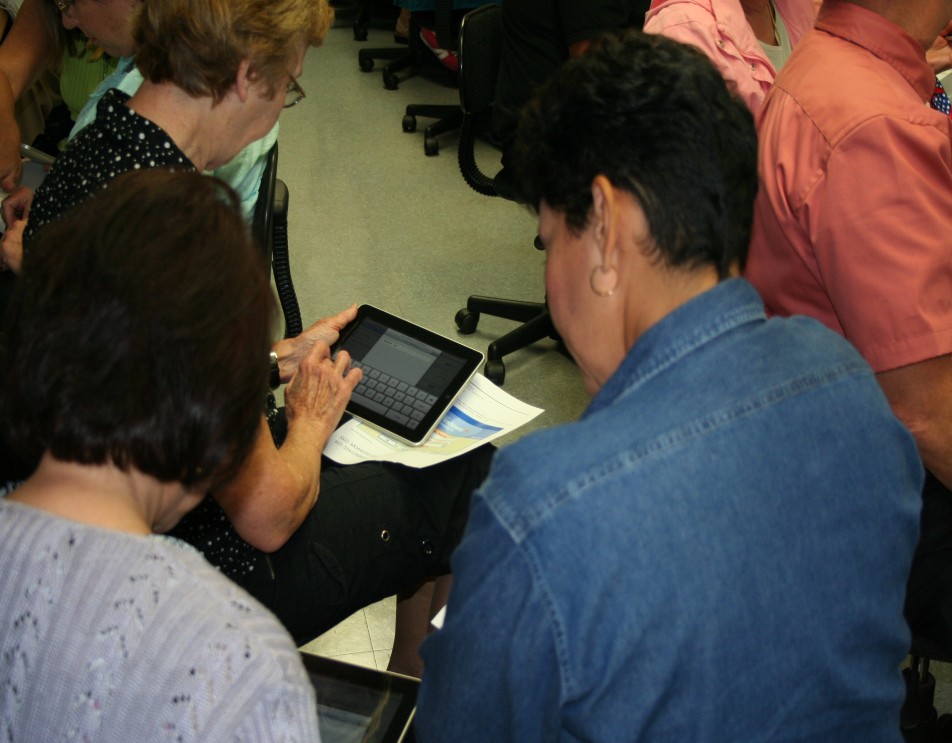

Slide 15
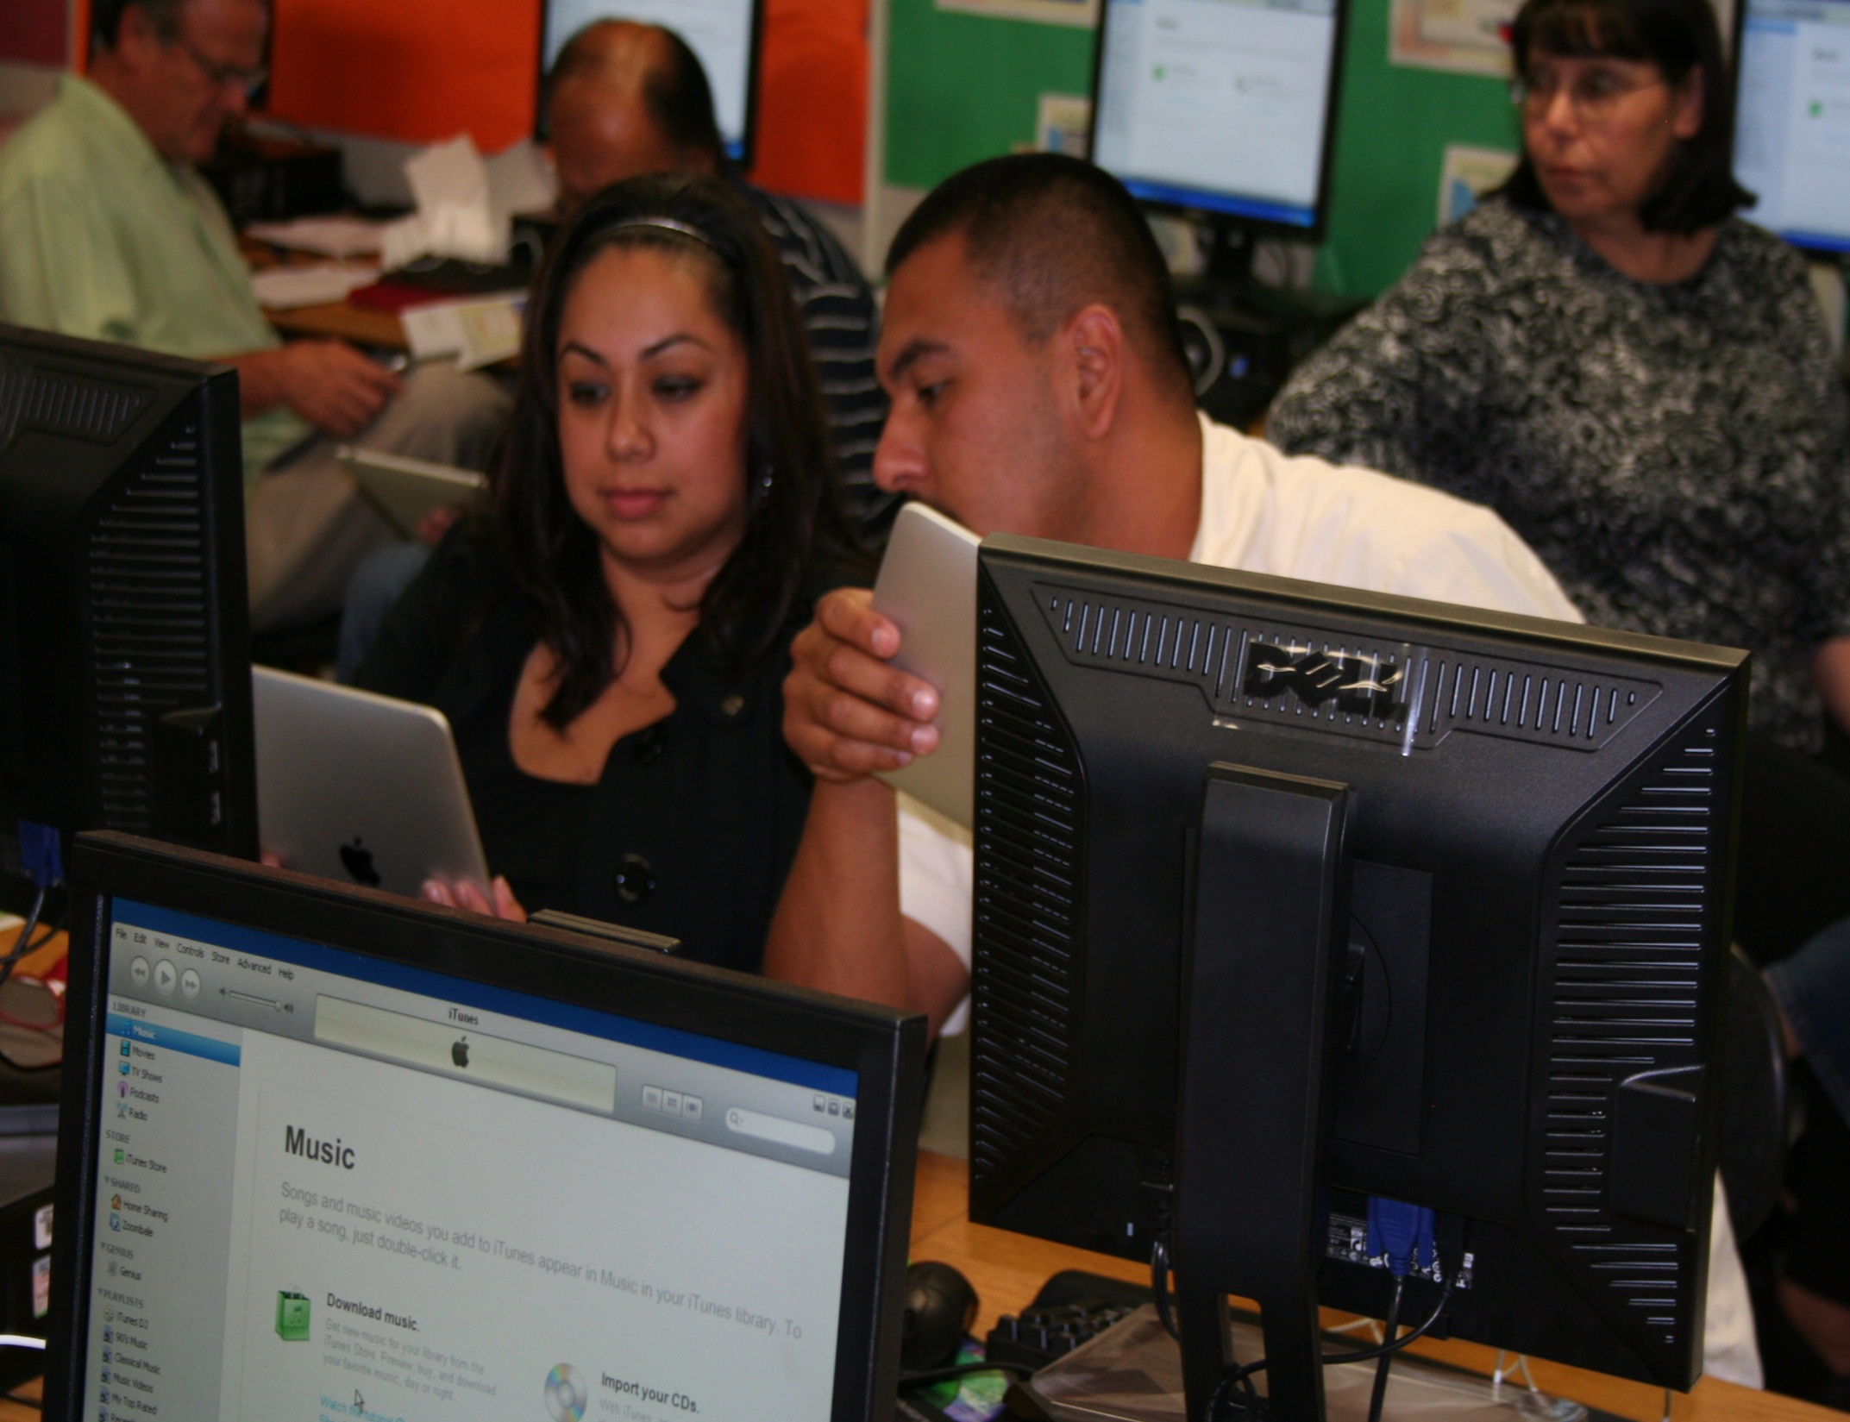

Slide 17
https://cueweb.cue.org/cueweb/PDW/PDWWebStore.aspx?pagecode=ipad

Slide 18
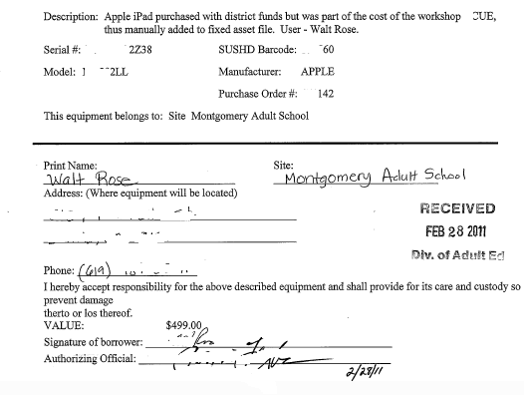

Slide 19
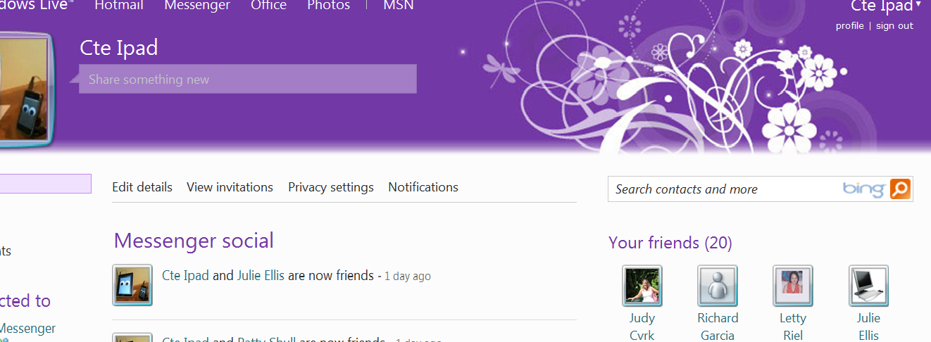

Slide 21
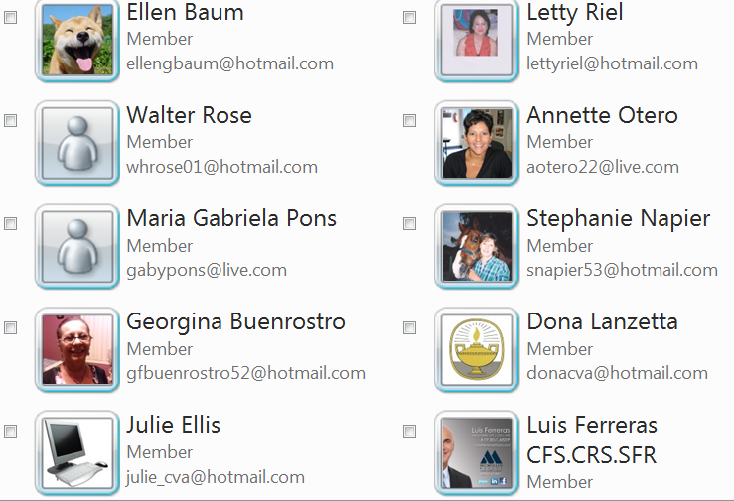

Slide 23
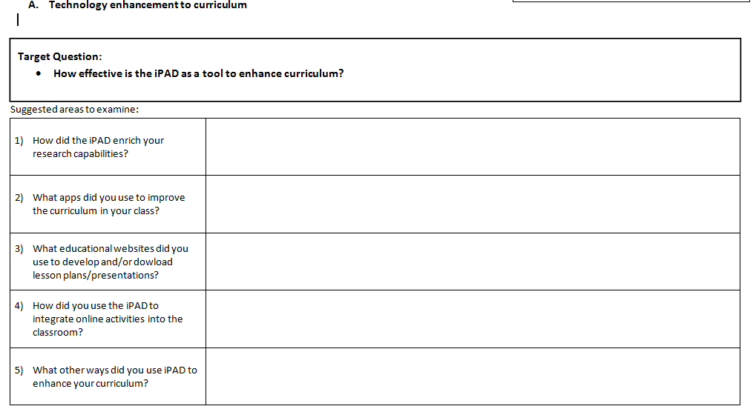

Slide 25
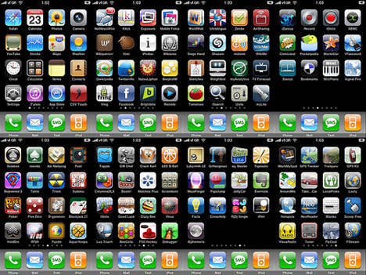
iPad Applications

Slide 26
Contact Us: Kristina Stanimirovich Sweetwater Union High School District Adult Division National City Adult School kristina.stanimirovich@sweetwaterschools.org Lidia Puga Sweetwater Union High School District Adult Division Montgomery Adult School lidia.puga@sweetwaterschools.org

